Slide 1
INTERPROCESS COMMUNICATION
From Chapter 4 of Distributed Systems Concepts and Design,4th Edition,
By G. Coulouris, J. Dollimore and T. Kindberg
Published by Addison Wesley/Pearson Education June 2005

Slide 2
Topics
INTRODUCTION The API for the INTERNET PROTOCOLS EXTERNAL DATA REPRESENTATION CLIENT-SERVER COMMUNICATION
Couloris,Dollimore and Kindberg Distributed Systems: Concepts & Design Edn. 4 , Pearson Education 2005

Slide 3
4.1 Introduction
A process can be: Independent process or Co-operating process.
An independent process is not affected by the execution of other processes while a co-operating process can be affected by other executing processes.
Processes running independently, will execute very efficiently but in practical, there are many situations when co-operative nature can be utilized for increasing computational speed, convenience and modularity.
Inter process communication (IPC) is a mechanism which allows processes to communicate each other and synchronize their actions.
Processes can communicate with each other using these two ways : Shared Memory or Message passing

Slide 4
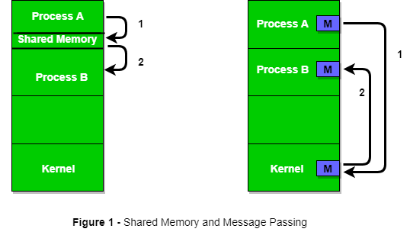
4.1 Introduction

Slide 5
4.1 Introduction
The java API for interprocess communication in the internet provides both datagram and stream communication. The communication patterns that are most commonly used in distributed programs: Client-Server communication The request and reply messages provide the basis for remote method invocation (RMI) or remote procedure call (RPC). Group communication The same message is sent to several processes Group multicast communication in which one process in a group transmits the same message to all members of the group

Slide 6
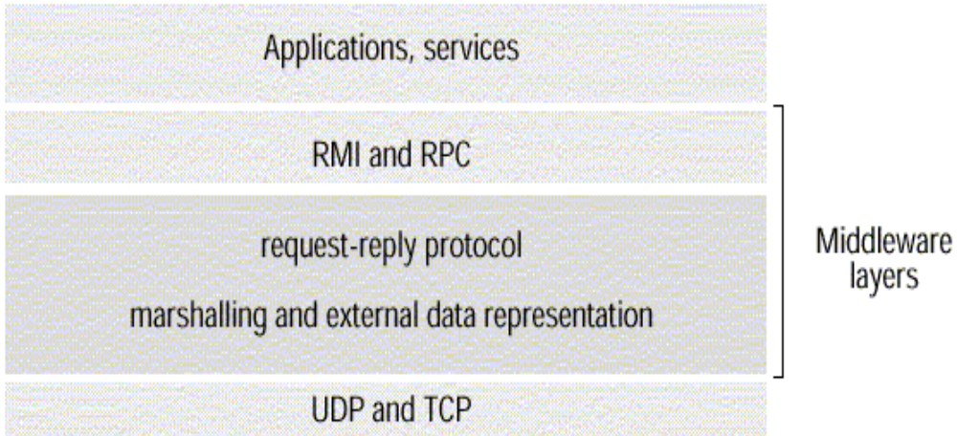
Introduction
This chapter is concerned with middleware.
Figure 1. Middleware layers

Slide 7
Introduction
Remote Method Invocation (RMI) It allows an object to invoke a method in an object in a remote process. E.g. CORBA and Java RMI Remote Procedure Call (RPC) It allows a client to call a procedure in a remote server.
Couloris,Dollimore and Kindberg Distributed Systems: Concepts & Design Edn. 4 , Pearson Education 2005

Slide 8
Introduction
The application program interface (API) to UDP provides a message passing abstraction. Message passing is the simplest form of interprocess communication. API enables a sending process to transmit a single message to a receiving process. The independent packets containing theses messages are called datagrams. In the Java and UNIX APIs, the sender specifies the destination using a socket.
Couloris,Dollimore and Kindberg Distributed Systems: Concepts & Design Edn. 4 , Pearson Education 2005

Slide 9
Introduction
Socket is an indirect reference to a particular port used by the destination process at a destination computer. The application program interface (API) to TCP provides the abstraction of a two-way stream between pairs of processes. The information communicated consists of a stream of data items with no message boundaries.
Couloris,Dollimore and Kindberg Distributed Systems: Concepts & Design Edn. 4 , Pearson Education 2005

Slide 10
4.2 The API for the Internet Protocols
The CHARACTERISTICS of INTERPROCESS COMMUNICATION SOCKET UDP DATAGRAM COMMUNICATION TCP STREAM COMMUNICATION
Couloris,Dollimore and Kindberg Distributed Systems: Concepts & Design Edn. 4 , Pearson Education 2005

Slide 11
4.2.1 The Characteristics of Interprocess Communication
SYSTEM MODEL
1. Synchronous and asynchronous communication In the synchronous form, both send and receive are blocking operations. Eg.Continous Chatting In the asynchronous form, the use of the send operation is non-blocking and the receive operation can have blocking and non-blocking variants. Eg.WhatsApp

Slide 12
The Characteristics of Interprocess Communication
2. Message destinations A local port is a message destination within a computer, specified as an integer. A port has an exactly one receiver but can have many senders.

Slide 13
The Characteristics of Interprocess Communication
3.Reliability A reliable communication is defined in terms of validity and integrity. A point-to-point message service is described as reliable if messages are guaranteed to be delivered despite a reasonable number of packets being dropped or lost. For integrity, messages must arrive uncorrupted and without duplication. 4.Ordering: Some applications require that messages to be delivered in sender order.

Slide 14
4.2 Sockets
A socket can be thought of as an endpoint in a two-way communication channel. Eg:telephone Call Internet IPC mechanism of Unix and other operating systems (BSD Unix, Solaris, Linux, Windows NT, Macintosh OS) Processes can send and receive messages via a socket. Sockets need to be bound to a port number and an internet address in order to send and receive messages. Each socket has a transport layer protocol (TCP or UDP).

Slide 15
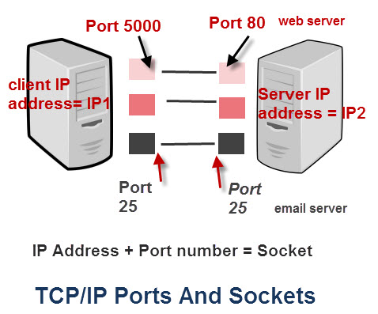
Sockets
Messages sent to some internet address and port number can only be received by a process using a socket that is bound to this address and port number.

Slide 16
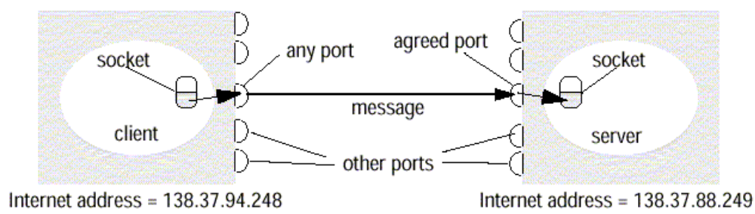
Sockets
Figure 2. Sockets and ports
Couloris,Dollimore and Kindberg Distributed Systems: Concepts & Design Edn. 4 , Pearson Education 2005

Slide 17
4.2.1UDP Datagram Communication
UDP datagram properties No guarantee of order preservation Message loss and duplications are possible Necessary steps Creating a socket Binding a socket to a port and local Internet address A client binds to any free local port A server binds to a server port Receive method It returns Internet address and port of sender, plus message.
Couloris,Dollimore and Kindberg Distributed Systems: Concepts & Design Edn. 4 , Pearson Education 2005

Slide 18
UDP Datagram Communication
Issues related to datagram communications are: Message size IP allows for messages of up to 2¹⁶ bytes. Most implementations restrict this to around 8k bytes. Any application requiring messages larger than the maximum must fragment. If arriving message is too big for array allocated to receive message content, truncation occurs.
Couloris,Dollimore and Kindberg Distributed Systems: Concepts & Design Edn. 4 , Pearson Education 2005

Slide 19
UDP Datagram Communication
Blocking Send: non-blocking upon arrival, message is placed in a queue for the socket that is bound to the destination port. Receive: blocking Pre-emption by timeout possible If process wishes to continue while waiting for packet, use separate thread Timeout Receive from any
Couloris,Dollimore and Kindberg Distributed Systems: Concepts & Design Edn. 4 , Pearson Education 2005

Slide 20
UDP Datagram Communication
UDP datagram's suffer from following failures: Omission failure Messages may be dropped occasionally Ordering
Couloris,Dollimore and Kindberg Distributed Systems: Concepts & Design Edn. 4 , Pearson Education 2005

Slide 21
Java API for UDP Datagrams
The Java API provides datagram communication by two classes: Datagram Packet It provides a constructor to make an array of bytes comprising: Message content Length of message Internet address Local port number It provides another similar constructor for receiving a message.
array of bytes containing message | length of message| Internet address | port number|

Slide 22
Java API for UDP Datagrams
Datagram Socket This class supports sockets for sending and receiving UDP datagram. It provides a constructor with port number as argument. Datagram Socket methods are: send and receive setSoTimeout connect
Couloris,Dollimore and Kindberg Distributed Systems: Concepts & Design Edn. 4 , Pearson Education 2005

Slide 23
4.2.2 TCP Stream Communication
The API to the TCP protocol provides the abstraction of a stream of bytes to be written to or read from. Characteristics of the stream abstraction: Message sizes: Application dependent Lost messages:Ack,Seq No. Flow control: Window size Message duplication & Ordering :Seq No Message destination:One time with IP &Port no.
Couloris,Dollimore and Kindberg Distributed Systems: Concepts & Design Edn. 4 , Pearson Education 2005

Slide 24
TCP Stream Communication
Issues related to stream communication: Matching of data items: data interpretation error w.r.t. use of data stream Blocking: Use of Queue destination Socket Threads: To avoid delay in handling clients

Slide 25
TCP Stream Communication
Use of TCP Many services that run over TCP connections, with reserved port number are: HTTP (Hypertext Transfer Protocol) FTP (File Transfer Protocol) Telnet SMTP (Simple Mail Transfer Protocol)
Couloris,Dollimore and Kindberg Distributed Systems: Concepts & Design Edn. 4 , Pearson Education 2005

Slide 26
TCP Stream Communication
Java API for TCP streams The Java interface to TCP streams is provided in the classes: ServerSocket It is used by a server to create a socket at server port to listen for connect requests from clients. Socket It is used by a pair of processes with a connection. The client uses a constructor to create a socket and connect it to the remote host and port of a server. It provides methods for accessing input and output streams associated with a socket.

Slide 27
4.3 External Data Representation
The information stored in running programs is represented as data structures, whereas the information in messages consists of sequences of bytes. Irrespective of the form of communication used, the data structure must be converted to a sequence of bytes before transmission and rebuilt on arrival.

Slide 28
External Data Representation
External Data Representation is an agreed standard for the representation of data structures and primitive values. Data representation problems are: Using agreed external representation, two conversions necessary Using sender’s or receiver’s format and convert at the other end
Couloris,Dollimore and Kindberg Distributed Systems: Concepts & Design Edn. 4 , Pearson Education 2005

Slide 29
External Data Representation
Marshalling Marshalling is the process of taking a collection of data items and assembling them into a form suitable for transmission in a message. Unmarshalling Unmarshalling is the process of disassembling a collection of data on arrival to produce an equivalent collection of data items at the destination.
Couloris,Dollimore and Kindberg Distributed Systems: Concepts & Design Edn. 4 , Pearson Education 2005

Slide 30
External Data Representation
Three approaches to external data representation and marshalling are: CORBA Java’s object serialization
Couloris,Dollimore and Kindberg Distributed Systems: Concepts & Design Edn. 4 , Pearson Education 2005

Slide 31
External Data Representation
Marshalling and unmarshalling activities is usually performed automatically by middleware layer. Marshalling is likely error-prone if carried out by hand.
Couloris,Dollimore and Kindberg Distributed Systems: Concepts & Design Edn. 4 , Pearson Education 2005

Slide 32
4.3.1 CORBA Common Data Representation (CDR)
CORBA Common Data Representation (CDR) CORBA CDR is the external data representation defined with CORBA 2.0. It consists 15 primitive types: Short (16 bit) Long (32 bit) Unsigned short Unsigned long Float(32 bit) Double(64 bit) Char Boolean(TRUE,FALSE) Octet(8 bit) Any(can represent any basic or constructed type) Composite type are shown in Figure 8.
Couloris,Dollimore and Kindberg Distributed Systems: Concepts & Design Edn. 4 , Pearson Education 2005

Slide 33
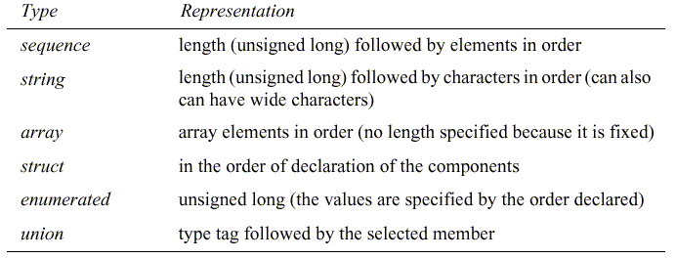
CORBA Common Data Representation (CDR)
Figure 8. CORBA CDR for constructed types

Slide 34
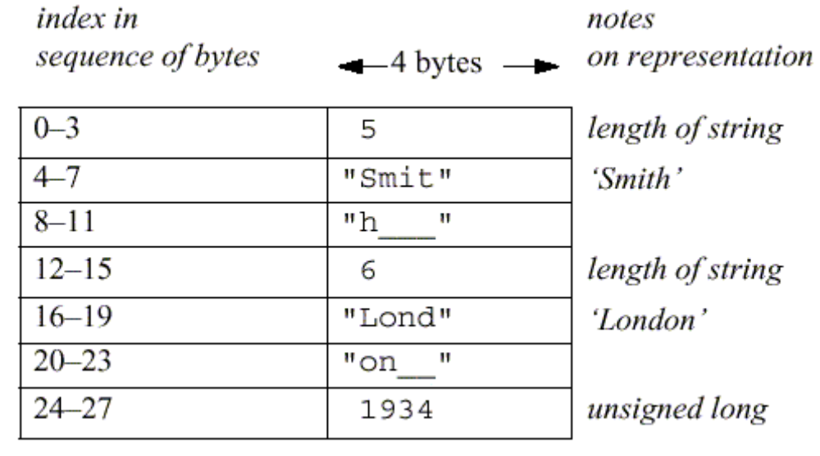
CORBA Common Data Representation (CDR)
Figure 9 shows a message in CORBA CDR that contains the three fields of a struct whose respective types are string, string, and unsigned long. example: struct with value {‘Smith’, ‘London’, 1934}
Figure 9. CORBA CDR message

Slide 35
4.3.2 Java object serialization
In Java RMI, both object and primitive data values may be passed as arguments and results of method invocation. An object is an instance of a Java class. Example, the Java class equivalent to the Person struct Public class Person implements Serializable { Private String name; Private String place; Private int year; Public Person(String aName ,String aPlace, int aYear) { name = aName; place = aPlace; year = aYear; } //followed by methods for accessing the instance variables }
Couloris,Dollimore and Kindberg Distributed Systems: Concepts & Design Edn. 4 , Pearson Education 2005

Slide 36
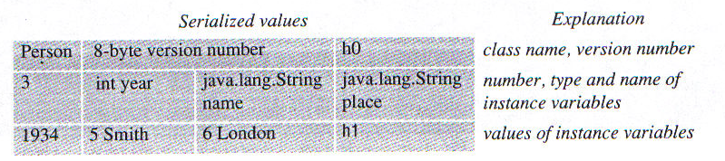
Java object serialization
The serialized form is illustrated in Figure 10.
Figure 10. Indication of Java serialization form
Couloris,Dollimore and Kindberg Distributed Systems: Concepts & Design Edn. 4 , Pearson Education 2005

Slide 37
Remote Object References
Remote object references are needed when a client invokes an object that is located on a remote server. A remote object reference is passed in the invocation message to specify which object is to be invoked. Remote object references must be unique over space and time.
Couloris,Dollimore and Kindberg Distributed Systems: Concepts & Design Edn. 4 , Pearson Education 2005

Slide 38
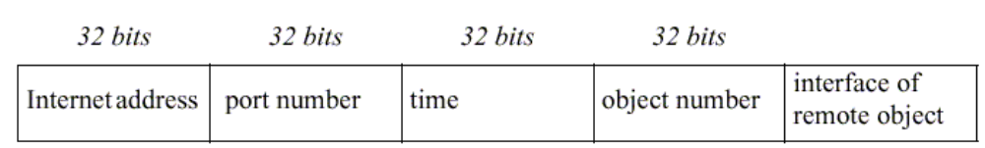
Remote Object References
In general, may be many processes hosting remote objects, so remote object referencing must be unique among all of the processes in the various computers in a distributed system. generic format for remote object references is shown in Figure 11.
Figure 11. Representation of a remote object references

Slide 39
Remote Object References
internet address/port number: process which created object time: creation time object number: local counter, incremented each time an object is created in the creating process interface: how to access the remote object (if object reference is passed from one client to another)
Couloris,Dollimore and Kindberg Distributed Systems: Concepts & Design Edn. 4 , Pearson Education 2005

Slide 40
4.4 Client-Server Communication
The client-server communication is designed to support the roles and message exchanges in typical client-server interactions. In the normal case, request-reply communication is synchronous because the client process blocks until the reply arrives from the server. Asynchronous request-reply communication is an alternative that is useful where clients won’t block & can afford to retrieve replies later.
Couloris,Dollimore and Kindberg Distributed Systems: Concepts & Design Edn. 4 , Pearson Education 2005

Slide 41
Client-Server Communication
Protocol often built over UDP datagram's UDP protocol avoids unnecessary overheads associated with TCP(Stream) protocol 1. acknowledgements are redundant, since requests are followed by replies;(piggybacked Ack’s) 2. Avoidance of connection establishment overhead which involves two extra pairs of msg’s. 3. No need for flow control due to small amounts of data (arguments/results) are transferred

Slide 42
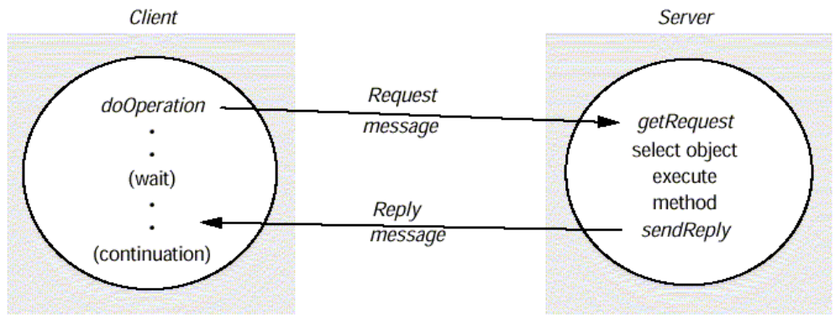
Client-Server Communication
The request-reply protocol was based on a trio of communication primitives: doOperation, getRequest, and sendReply shown in Figure 12. Illustrates RMI example
Figure 12. Request-reply communication

Slide 43
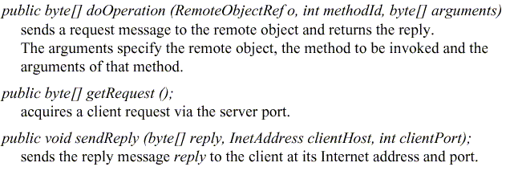
Client-Server Communication
Figure 13 outlines the three communication primitives.
Figure 13. Operations of the request-reply protocol

Slide 44
Client-Server Communication
Figure 13. Operations of the request-reply protocol
Couloris,Dollimore and Kindberg Distributed Systems: Concepts & Design Edn. 4 , Pearson Education 2005

Slide 45
Client-Server Communication
Three Premitives:
1.doOperation method
used by the client to invoke remote operations
Arguments→ object & method to be invoked
Its result is an RMI Reply
Client calling doOperation marshals the arguments into an array of bytes & unmarshals the results from the array of bytes
Client doOperation is blocked until remote object in the server performs the requested operation & transmits a reply msg back
2.GetRequest
-used by a server process to acquire service requests
-when server has invoked the method in the object it then uses
3.SendReply is used to send reply to client.
-when reply msg is received doOperation is unblocked & client continues to execute

Slide 46
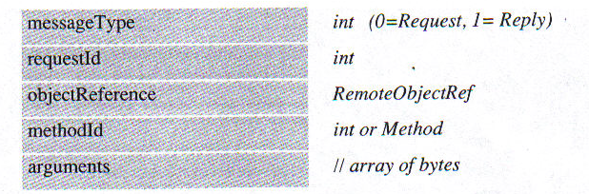
Client-Server Communication
The information to be transmitted in a request message or a reply message is shown in Figure 14.
Figure 14. Request-reply message structure
Couloris,Dollimore and Kindberg Distributed Systems: Concepts & Design Edn. 4 , Pearson Education 2005

Slide 47
Client-Server Communication
In a protocol message The first field indicates whether the message is a request or a reply message. The second field request id contains a message identifier. A message identifier consists of two parts: A requestId, which is taken from an increasing sequence of integers by the sending process An identifier for the sender process, for example its port and Internet address The third field is a remote object reference . The forth field is an identifier for the method to be invoked followed by arguments

Slide 48
Client-Server Communication
Failure model of the request-reply protocol If these three primitives are implemented over UDP they have the same communication failures
Omission failure (link failures, drops/losses, missed/corrupt addresses)
Out-of-order delivery
Node/process down
Solved by
Timeouts with retrans until reply is received/confirmed
Discards of repeated requests by requestId (by server process)
On lost reply messages, server repeats idempotent operations(eg.adding an element to set)
Maintain history (reqid, message, client-id) or buffer replies and retrans – memory intensive

Slide 49
Client-Server Communication
RPC exchange protocols(failure handling) Three protocols are used for implementing various types of RPC. The request (R) protocol. The request-reply (RR) protocol. The request-reply-acknowledge (RRA) protocol. (Figure 15)
Couloris,Dollimore and Kindberg Distributed Systems: Concepts & Design Edn. 4 , Pearson Education 2005

Slide 50
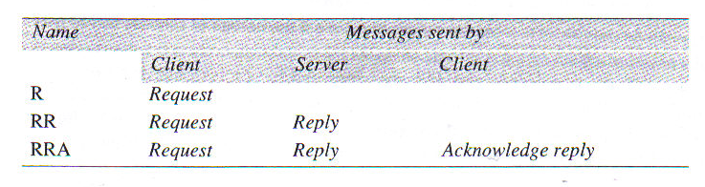
Client-Server Communication
Figure 15. RPC exchange protocols
Couloris,Dollimore and Kindberg Distributed Systems: Concepts & Design Edn. 4 , Pearson Education 2005

Slide 51
Client-Server Communication
In the R protocol, a single request message is sent by the client to the server. The R protocol may be used when there is no value to be returned from the remote method. The RR protocol is useful for most client-server exchanges because it is based on request-reply protocol. RRA protocol is based on the exchange of three messages: request-reply-acknowledge reply.
Couloris,Dollimore and Kindberg Distributed Systems: Concepts & Design Edn. 4 , Pearson Education 2005

Slide 52
Client-Server Communication
HTTP: an example of a request-reply protocol HTTP is a request-reply protocol for the exchange of network resources between web clients and web servers. Client requests specify a URL that includes DNS Host name+Port no.+resource identifier on that port HTTP Allows→Content Negotiation & Authentication Content negotiation→ negotiating for appropriate data representations between client & server Password Style Authentication

Slide 53
Client-Server Communication
HTTP protocol steps for C/S interaction: Connection establishment between client and server at the default server port or at a port specified in the URL client sends a request server sends a reply connection closure
Couloris,Dollimore and Kindberg Distributed Systems: Concepts & Design Edn. 4 , Pearson Education 2005

Slide 54
Client-Server Communication
Need to establish & close connection for every requqst-reply exchange is expensive Request & reply are marshalled into msgs as ASCII text Resources can have MIME(Multipurpose Internet Mail Extension)-like structures in arguments and results Data is prefixed with Mime type so that recipient will know how to handle it Mime type specifies a type and a subtype, for example: text/plain, text/html, image/gif, image/jpeg

Slide 55
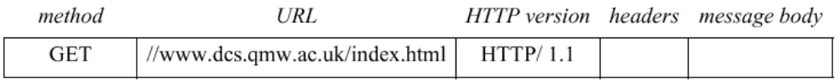
Client-Server Communication
HTTP methods Client Rqst=method+URL GET Requests the resource, identified by URL as argument. If the URL refers to data, then the web server replies by returning the data If the URL refers to a program, then the web server runs the program and returns the output to the client.
Figure 16. HTTP request message
Couloris,Dollimore and Kindberg Distributed Systems: Concepts & Design Edn. 4 , Pearson Education 2005

Slide 56
Client-Server Communication
HEAD This method is similar to GET, but only meta data on resource is returned (like date of last modification, type, and size) i.e status line
Couloris,Dollimore and Kindberg Distributed Systems: Concepts & Design Edn. 4 , Pearson Education 2005

Slide 57
Client-Server Communication
POST Specifies the URL of a resource (for instance, a server program) that can deal with the data supplied with the request. This method is designed to deal with: Providing a block of data to a data-handling process Posting a message to a bulletin board, mailing list or news group. Extending a dataset with an append operation
Couloris,Dollimore and Kindberg Distributed Systems: Concepts & Design Edn. 4 , Pearson Education 2005

Slide 58
Client-Server Communication
PUT Supplied data to be stored in the given URL as its identifier. DELETE The server deletes an identified resource by the given URL on the server. TRACE The server sends back the request message OPTIONS A server supplies the client with a list of methods. It allows to be applied to the given URL

Slide 59
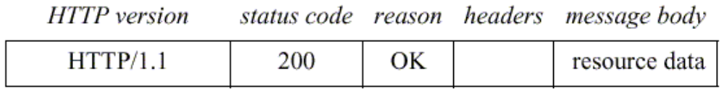
Client-Server Communication
A reply message specifies The protocol version A status code Reason Some headers An optional message body
Figure 17. HTTP reply message
Couloris,Dollimore and Kindberg Distributed Systems: Concepts & Design Edn. 4 , Pearson Education 2005

Slide 60
Client-Server Communication
Status codes
100 block→Informational→Eg. 103 – checkpoint
200 block→Success→ Eg.200-OK, 201-created
300 block→Redirection→Eg.302-Found, 304-Not Modified
400 block→Client Error→ Eg.404-Not Found 408-Request Timeout
500 block→Server error→Eg.500-Internal Server Error, 502-Bad Gateway, 503-Service Unavailable

